Slide 1


Slide 2
Sunday 25 September
..the Son is the image of the invisible God, the firstborn over all creation… Colossians 1:15

Slide 3
Morning Service
Simply The Best: The Best Man Colossians 1:15-20
Rev Jerry Middleton

Slide 4
The earth belongs unto the Lord, and all that it contains; the world that is inhabited, and all that there remains. For the foundations thereof He on the seas did lay, and He hath it established upon the floods to stay.

Slide 5
Who is the man that shall ascend into the hill of God? Or who within His holy place shall have a firm abode? Whose hands are clean, whose heart is pure and unto vanity who hath not lifted up his soul, nor sworn deceitfully.

Slide 6
He from th’Eternal shall receive the blessing him upon, and righteousness, ev’n from the God of his salvation. This is the generation that after Him enquire, O Jacob, who do seek Thy face with their whole heart’s desire.

Slide 7
Ye gates, lift up your heads on high; ye doors that last for aye, be lifted up that so the King of glory enter may. (Men) But who of glory is the King? (Women) The mighty Lord is this; (All) Ev’n that same Lord, that great in might and strong in battle is.

Slide 8
Ye gates, lift up your heads; ye doors, doors that do last for aye, be lifted up, that so the King of glory enter may.

Slide 9
(Men) But who is he that is the King, (Women) the King of glory? who is this? (All) The Lord of hosts, and none but he, the King of glory is.

Slide 10
Hallelujah! Hallelujah! Hallelujah! Hallelujah! Hallelujah! Amen! Amen! Amen! Psalm 24

Slide 11
Prayer

Slide 12

¹⁵ The Son is the image of the invisible God, the firstborn over all creation. ¹⁶ For in him all things were created: things in heaven and on earth, visible and invisible, whether thrones or powers or rulers or authorities; all things have been created through him and for him. ¹⁷ He is before all things, and in him all things hold together. ¹⁸ And he is the head of the body, the church; he is the beginning and the firstborn from among the dead, so that in everything he might have the supremacy.
Colossians 1.¹⁵⁻²⁰

Slide 13
¹⁹ For God was pleased to have all his fullness dwell in him, ²⁰ and through him to reconcile to himself all things, whether things on earth or things in heaven, by making peace through his blood, shed on the cross.
Colossians 1.¹⁵⁻²⁰

Slide 14
Children’s Talk

Slide 15
Come on, come in, everybody! There is a God who is worthy of all our praise – He alone is Lord. Come on and join with creation, let everything shout to praise Him, Glory to Christ – He’s the one who made us.

Slide 16
Lift up your voices to heaven’s king, bow down before His throne. Our perfect Saviour died for our sin. Hallelujah! Praise to Jesus Christ the king.

Slide 17
Come on, come in, all you weary, come on and find rest with Jesus, He is the one who can heal your soul. Come on and join with the angels, praising the Lamb who was faithful, Giving His life – He’s the one who saved us.

Slide 18
Lift up your voices to heaven’s king, bow down before His throne. Our perfect Saviour died for our sin. Hallelujah! Praise to Jesus Christ the king.

Slide 19
Come on, you saints, keep believing, gather to hear the Lord speaking. Humble your hearts, tremble at His voice. Come in with joy for the future, He will renew heaven and earth, Jesus is Lord – He’s the one who’ll raise us.

Slide 20
Lift up your voices to heaven’s king, bow down before His throne. Our perfect Saviour died for our sin. Hallelujah! Praise to Jesus Christ the king. © 2019 Dan Adams & Gareth Loh All words reproduced under CCLI no 293885

Slide 21
Prayer

Slide 22
Message
Simply The Best
The Best Man
Colossians 1:15-20
Notes:
When I begin the message bring up the next slide

Slide 23
Prayer

Slide 24
Hark how the adoring hosts above with songs surround the throne! Ten thousand, thousand are their tongues; but all their hearts are one.

Slide 25
Worthy the Lamb that died, they cry, to be exalted thus; worthy the Lamb, let us reply; for He was slain for us.

Slide 26
Thou hast redeemed us with Thy blood, and set the prisoners free; Thou mad’st us kings and priests to God, and we shall reign with Thee.

Slide 27
From every kindred, every tongue, Thou brought’st Thy chosen race; and distant lands and isles have shared the riches of Thy grace.

Slide 28
To Him who sits upon the throne, the God whom we adore, and to the Lamb that once was slain, be glory evermore. Scottish Paraphrases 1781

Slide 29
Sacrament

Slide 30
His Name for ever shall endure; last like the sun it shall: men shall be blest in Him, and blest all nations shall Him call.

Slide 31
Now blessed be the Lord our God, the God of Israel, for He alone doth wondrous works, in glory that excel.

Slide 32
And blessed be His glorious Name to all eternity: the whole earth let His glory fill. Amen, so let it be. Psalm 72. All words reproduced under CCLI no 293885

Slide 33
The grace of our Lord Jesus Christ, the love of God and the fellowship of the Holy Spirit, be with us all. Amen.
Notes:
Once the service has ended, please bring up the sequence of slides which follow

Slide 34
Evening Service
Spiralling Down: How Will Your Story End?
2 Kings 17:1-23
Rev Jerry Middleton

Slide 35
Praise to the Lord, the Almighty, the King of creation; O my soul, praise Him for He is your health and salvation! Come, all who hear, brothers and sisters, draw near, praise Him in glad adoration.

Slide 36
Praise to the Lord, above all things so mightily reigning; keeping us safe at His side, and so gently sustaining. Have you not seen all you have needed has been met by His gracious ordaining?

Slide 37
Praise to the Lord, who shall prosper our work and defend us; surely His goodness and mercy shall daily attend us. Ponder anew what the Almighty can do, who with His love will befriend us.

Slide 38
Praise to the Lord, who, when darkness and sin are abounding, who, when the godless are rampant, all goodness confounding, breaks forth as light, scatters the terrors of night, saints with His mercy surrounding!

Slide 39
Praise to the Lord! O let all that is in me adore Him; all that has life and breath, come now with praises before Him! Let the ‘Amen!’ sound from His people again - gladly we praise and adore Him. Joachim Neander, Tr. Catherine Winkworth and Percy Dearmer All words reproduced under CCLI No 293885

Slide 40
Prayer
Notes:
When I speak about THE WORKSHEETS FOR CHILDREN bring up the next slide

Slide 41
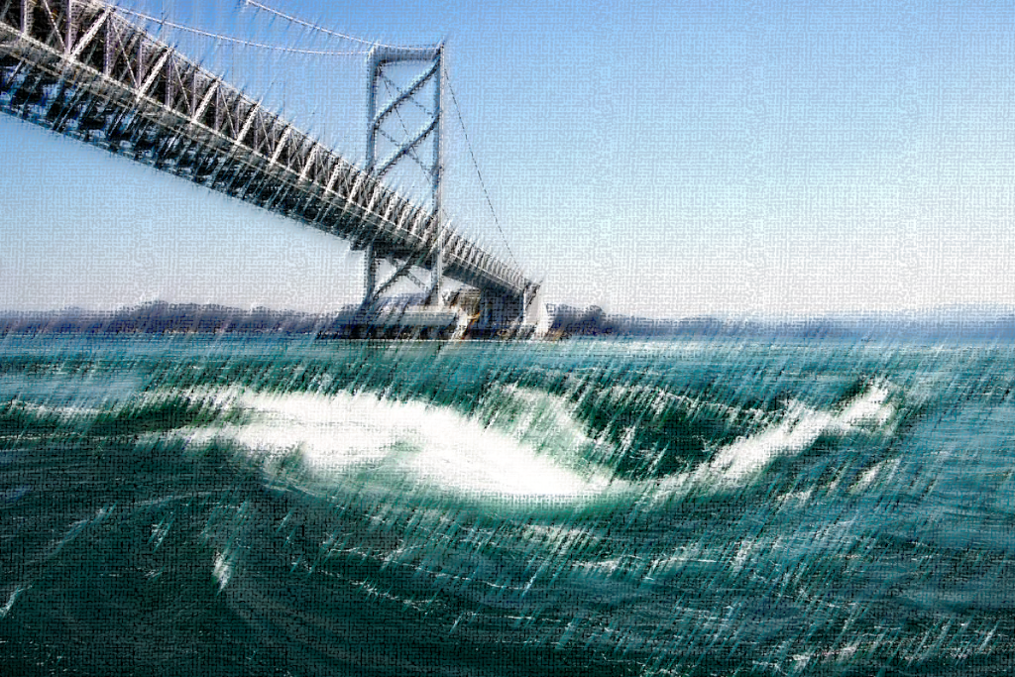
In the twelfth year of Ahaz king of Judah, Hoshea son of Elah became king of Israel in Samaria, and he reigned nine years. ² He did evil in the eyes of the Lord, but not like the kings of Israel who preceded him.
³ Shalmaneser king of Assyria came up to attack Hoshea, who had been Shalmaneser’s vassal and had paid him tribute. ⁴ But the king of Assyria discovered that Hoshea was a traitor, for he had sent envoys to So king of Egypt, and he no longer paid tribute to the king of Assyria, as he had done year by year.
2 Kings 17.¹⁻²³

Slide 42
Therefore Shalmaneser seized him and put him in prison. ⁵ The king of Assyria invaded the entire land, marched against Samaria and laid siege to it for three years. ⁶ In the ninth year of Hoshea, the king of Assyria captured Samaria and deported the Israelites to Assyria. He settled them in Halah, in Gozan on the Habor River and in the towns of the Medes.
⁷ All this took place because the Israelites had sinned against the Lord their God, who had brought them up out of Egypt from under the power of Pharaoh king of Egypt.
2 Kings 17.¹⁻²³

Slide 43
They worshiped other gods ⁸ and followed the practices of the nations the Lord had driven out before them, as well as the practices that the kings of Israel had introduced. ⁹ The Israelites secretly did things against the Lord their God that were not right. From watchtower to fortified city they built themselves high places in all their towns. ¹⁰ They set up sacred stones and Asherah poles on every high hill and under every spreading tree. ¹¹ At every high place they burned incense, as the nations whom the Lord had driven out before them had done.
2 Kings 17.¹⁻²³

Slide 44
They did wicked things that aroused the Lord’s anger. ¹² They worshiped idols, though the Lord had said, “You shall not do this.”¹³ The Lord warned Israel and Judah through all his prophets and seers: “Turn from your evil ways. Observe my commands and decrees, in accordance with the entire Law that I commanded your ancestors to obey and that I delivered to you through my servants the prophets.”
¹⁴ But they would not listen and were as stiff-necked as their ancestors, who did not trust in the Lord their God.
2 Kings 17.¹⁻²³

Slide 45
¹⁵ They rejected his decrees and the covenant he had made with their ancestors and the statutes he had warned them to keep. They followed worthless idols and themselves became worthless. They imitated the nations around them although the Lord had ordered them, “Do not do as they do.”
¹⁶ They forsook all the commands of the Lord their God and made for themselves two idols cast in the shape of calves, and an Asherah pole. They bowed down to all the starry hosts, and they worshiped Baal.
2 Kings 17.¹⁻²³

Slide 46
¹⁷ They sacrificed their sons and daughters in the fire. They practiced divination and sought omens and sold themselves to do evil in the eyes of the Lord, arousing his anger.
¹⁸ So the Lord was very angry with Israel and removed them from his presence. Only the tribe of Judah was left, ¹⁹ and even Judah did not keep the commands of the Lord their God. They followed the practices Israel had introduced. ²⁰ Therefore the Lord rejected all the people of Israel;
2 Kings 17.¹⁻²³

Slide 47
he afflicted them and gave them into the hands of plunderers, until he thrust them from his presence.
²¹ When he tore Israel away from the house of David, they made Jeroboam son of Nebat their king. Jeroboam enticed Israel away from following the Lord and caused them to commit a great sin. ²² The Israelites persisted in all the sins of Jeroboam and did not turn away from them ²³ until the Lord removed them from his presence, as he had warned through all his servants the prophets.
2 Kings 17.¹⁻²³

Slide 48
So the people of Israel were taken from their homeland into exile in Assyria, and they are still there.
2 Kings 17.¹⁻²³

Slide 49
There is a hope that burns within my heart, that gives me strength for ev’ry passing day; a glimpse of glory now revealed in meagre part, yet drives all doubt away: I stand in Christ, with sins forgiv’n; and Christ in me, the hope of heav’n! My highest calling and my deepest joy, to make His will my home.

Slide 50
There is a hope that lifts my weary head, a consolation strong against despair, that when the world has plunged me in its deepest pit, I find the Saviour there! Through present sufferings, future’s fear, He whispers ‘courage’ in my ear. For I am safe in everlasting arms, and they will lead me home.

Slide 51
There is a hope that stands the test of time, that lifts my eyes beyond the beckoning grave, to see the matchless beauty of a day divine, when I behold His face! When sufferings cease and sorrows die, and every longing satisfied, then joy unspeakable will flood my soul, for I am truly home. Stuart Townend & Mark Edwards © 2007 Thankyou Music All words reproduced under CCLI no 293885

Slide 52
Prayer
Notes:
When I speak about people upstairs coming down for the sacrament bring up the next slide

Slide 53
Message
Spiralling Down How Will Your Story End?
2 Kings 17:1-23
Notes:
When (if) I speak about THE WORKSHEETS FOR CHILDREN bring up the next slide

Slide 54
‘Spiralling down’
Notes:
When I speak about THE FALLENNESS OF MAN bring up the next slide

Slide 55
Prayer
Notes:
When I speak about people upstairs coming down for the sacrament bring up the next slide

Slide 56
The day Thou gavest, Lord, is ended; the darkness falls at Thy behest; To Thee our morning hymns ascended, Thy praise shall sanctify our rest.

Slide 57
We thank Thee that Thy Church unsleeping, while earth rolls onward into light, through all the world her watch is keeping, and rests not now by day or night.

Slide 58
As o’er each continent and island the dawn leads on another day, the voice of prayer is never silent, nor dies the strain of praise away.

Slide 59
The sun that bids us rest is waking our brethren ‘neath the western sky, and hour by hour fresh lips are making Thy wondrous doings heard on high.

Slide 60
So be it, Lord! Thy throne shall never, like earth’s proud empires, pass away; Thy Kingdom stands and grows for ever, till all Thy creatures own Thy sway.
John Ellerton, 1826-93
All words reproduced under CCLI no 293885

Slide 61
The grace of our Lord Jesus Christ, the love of God and the fellowship of the Holy Spirit, be with us all. Amen.

Slide 62
Church Calendar
You’ll find dates for your diary on our website:
http://www.gilcomston.org/calendar
Notes:
When the prayer is finished bring up the next slide

