Slide 1
Morning Service
The worst kept secret in the world
Matthew 5:13-16
Rev Nathan Owens

Slide 2
Now thank we all our God, with heart and hands and voices, who wondrous things hath done, in whom His world rejoices, - who, from our mothers’ arms, hath blessed us on our way with countless gifts of love, and still is ours today.

Slide 3
O may this bounteous God through all our life be near us, with ever-joyful hearts and blessed peace to cheer us, and keep us in His grace, and guide us when perplexed, and free us from all ills in this world and the next.

Slide 4
All praise and thanks to God the Father now be given, the Son, and Him who reigns with Them in highest heaven, - the one, eternal God, whom earth and heaven adore; for thus it was, is now, and shall be evermore. Martin Rinkart, 1586-1649, tr. By Catherine Winkworth, 1829-78 All words reproduced under CCLI no 293885

Slide 5
Prayer

Slide 6
Matthew 5:13-16
¹³ “You are the salt of the earth, but if salt has lost its taste, how shall its saltiness be restored? It is no longer good for anything except to be thrown out and trampled under people's feet.

Slide 7
Matthew 5:13-16
¹⁴ “You are the light of the world. A city set on a hill cannot be hidden. ¹⁵ Nor do people light a lamp and put it under a basket, but on a stand, and it gives light to all in the house.

Slide 8
Matthew 5:13-16
¹⁶ In the same way, let your light shine before others, so that they may see your good works and give glory to your Father who is in heaven.

Slide 9
Children’s talk

Slide 10
Jesus wants me to be a bright light shining in the darkness so people can see. Jesus wants me to be a brave flame burning with His love as He wants me to be.

Slide 11
Though it’s hard, I know when the feelings go and the darkness is pressing me in, but I’ll carry on for His love is strong, it’s His light that will make me shine, it’s His light that will make me shine. Crawford Mackenzie © 1992 Tollcross Songs All words reproduced under CCLI no 293885

Slide 12
Prayer

Slide 13
Born by the Holy Spirit’s breath, loosed from the law of sin and death, now cleared in Christ from every claim, no judgement stands against our name.

Slide 14
In us the Spirit makes His home that we in Him may overcome; Christ’s risen life, in all its powers, its all-prevailing strength, is ours.

Slide 15
Sons, then, and heirs of God most high, we by His Spirit ‘Father’ cry; that Spirit with our spirit shares to frame and breathe our wordless prayers.

Slide 16
One is His love, His purpose one: to form the likeness of His Son in all who, called and justified, shall reign in glory at His side.

Slide 17
Nor death nor life, nor powers unseen, nor height nor depth can come between; we know through peril, pain and sword, the love of God in Christ our Lord. Timothy Dudley-Smith © Author All words are reproduced under Christian Copyright licence no. 293885

Slide 18

The pleasant lands of God’s peaceful grace

Slide 19
Prayer

Slide 20
In the bread, in the wine LORD remember him: on the cross, long ago dying for our sin. ‘Eat’ said he, ‘drink the cup: this, my blood, for you’. Blessing sealed evermore, covenant made new!

Slide 21
See the bread, see the wine: Christ proclaimed for me! His the death, mine the life, this your promise free! Still, O Lord, do I fear: Would I fall away? Peter-like, weak am I; you I oft betray!

Slide 22
Oh! The bread and the wine, ever is my plea: at the cross of your Son Lord remember me! ‘Fear not child, trust in God; rest your trust in me! Waits our house, now prepared, there your place shall be!’

Slide 23
In the bread, in the wine, seal your vow to me; See the bread, see the wine: Lord remember me! Lord remember me!
William J.U. Philip

Slide 24
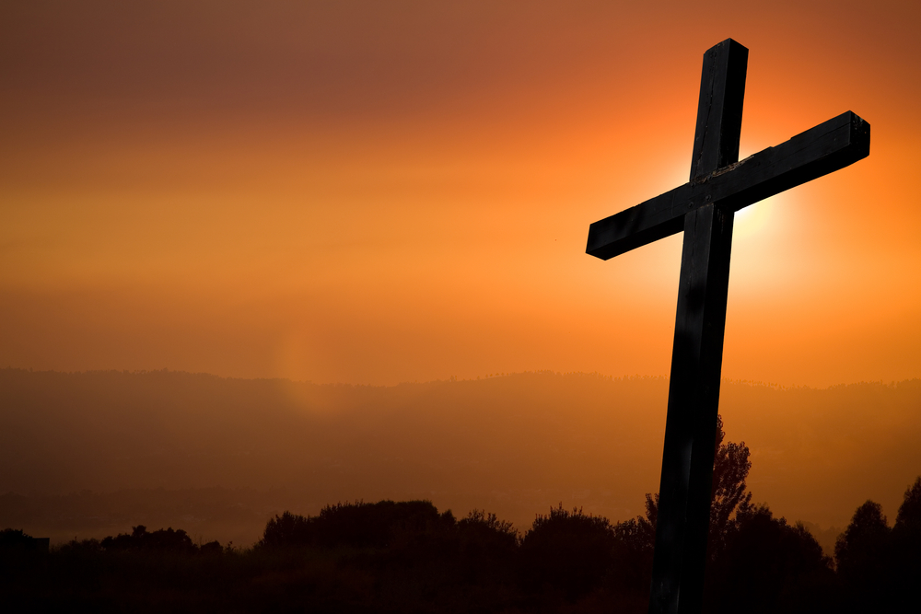
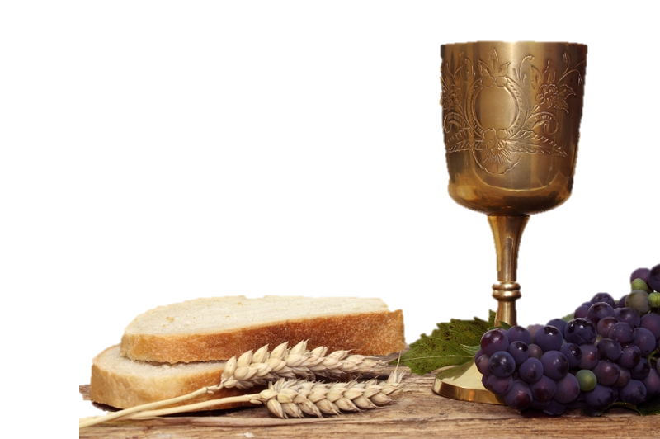
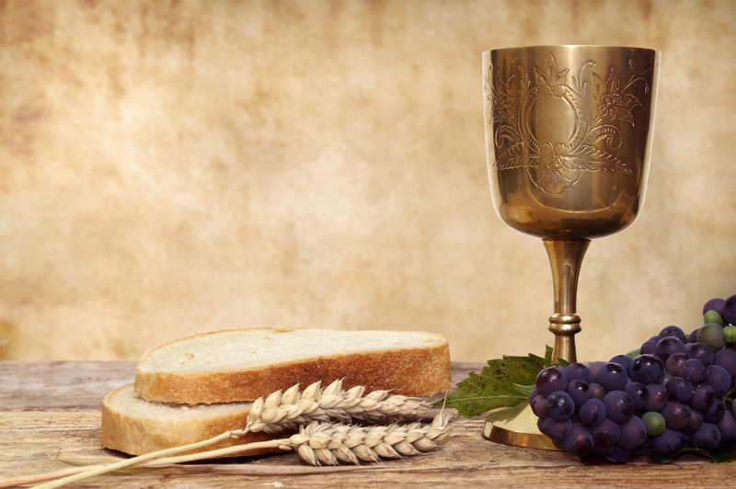

Slide 25
Lord, the light of Your love is shining, in the midst of the darkness, shining; Jesus, Light of the world, shine upon us, set us free by the truth You now bring us, shine on me, shine on me.

Slide 26
Shine, Jesus, shine, fill this land with the Father’s glory; blaze, Spirit, blaze, set our hearts on fire. Flow, river, flow, flood the nations with grace and mercy; send forth Your word, Lord, and let there be light.

Slide 27
Lord, I come to Your awesome presence, from the shadows into Your radiance; by the blood I may enter Your brightness, search me, try me, consume all my darkness. Shine on me, shine on me.

Slide 28
Shine, Jesus, shine, fill this land with the Father’s glory; blaze, Spirit, blaze, set our hearts on fire. Flow, river, flow, flood the nations with grace and mercy; send forth Your word, Lord, and let there be light.

Slide 29
As we gaze on Your kingly brightness so our faces display Your likeness. Ever changing from glory to glory, mirrored here may our lives tell Your story. Shine on me, shine on me.

Slide 30
Shine, Jesus, shine, fill this land with the Father’s glory; blaze, Spirit, blaze, set our hearts on fire. Flow, river, flow, flood the nations with grace and mercy; send forth Your word, Lord, and let there be light. Graham Kendrick © 1987 Make Way Music All words reproduced under CCLI no 293885

Slide 31
The grace of our Lord Jesus Christ, the love of God and the fellowship of the Holy Spirit, be with us all. Amen.
Notes:
Once the service has ended, please bring up the sequence of slides which follow

Slide 32
Evening Service
God’s glorious compassion Jonah 4 Rev Nathan Owens

Slide 33
Come, Thou Almighty King, help us Thy Name to sing, help us to praise: Father all-glorious, o’er all victorious, come and reign over us, Ancient of Days!

Slide 34
Come, Thou Incarnate Word, gird on Thy mighty sword, our prayers attend; come, and Thy people bless, and give Thy Word success; Spirit of holiness, on us descend!

Slide 35
Come, Holy Comforter, Thy sacred witness bear in this glad hour: Thou, who almighty art, now rule in every heart, and ne’er from us depart, Spirit of power!

Slide 36
To the great One in Three, eternal praises be, hence evermore: His sovereign majesty may we in glory see, and to eternity love and adore! Anonymous c.1757 All words are reproduced under Christian copyright licence no. 293885

Slide 37
Prayer

Slide 38
Beneath the cross of Jesus, I find a place to stand; and wonder at such mercy that calls me as I am. For hands that should discard me, hold wounds which tell me ‘come’. Beneath the cross of Jesus my unworthy soul is won.

Slide 39
Beneath the cross of Jesus His family is my own. Once strangers chasing selfish dreams, now one through grace alone. How could I now dishonour the ones that You have loved? Beneath the cross of Jesus see the children called by God.

Slide 40
Beneath the cross of Jesus, the path before the crown, we follow in His footsteps where promised hope is found. How great the joy before us to be His perfect bride. Beneath the cross of Jesus we will gladly live our lives.

Slide 41
How great the joy before us to be His perfect bride. Beneath the cross of Jesus we will gladly live our lives. Keith and Kristyn Getty © 2005 Thankyou Music

Slide 42
Jonah 4
But it displeased Jonah exceedingly, and he was angry. ² And he prayed to the Lord and said, “O Lord, is not this what I said when I was yet in my country?

Slide 43
Jonah 4
That is why I made haste to flee to Tarshish; for I knew that you are a gracious God and merciful, slow to anger and abounding in steadfast love, and relenting from disaster.

Slide 44
Jonah 4
³ Therefore now, O Lord, please take my life from me, for it is better for me to die than to live.” ⁴ And the Lord said, “Do you do well to be angry?”

Slide 45
Jonah 4
⁵ Jonah went out of the city and sat to the east of the city and made a booth for himself there. He sat under it in the shade, till he should see what would become of the city.

Slide 46
Jonah 4
⁶ Now the Lord God appointed a plant and made it come up over Jonah, that it might be a shade over his head, to save him from his discomfort. So Jonah was exceedingly glad because of the plant.

Slide 47
Jonah 4
⁷ But when dawn came up the next day, God appointed a worm that attacked the plant, so that it withered. ⁸ When the sun rose, God appointed a scorching east wind, and the sun beat down on the head of Jonah so that he was faint.

Slide 48
Jonah 4
And he asked that he might die and said, “It is better for me to die than to live.” ⁹ But God said to Jonah, “Do you do well to be angry for the plant?” And he said, “Yes, I do well to be angry, angry enough to die.”

Slide 49
Jonah 4
¹⁰ And the Lord said, “You pity the plant, for which you did not labour, nor did you make it grow, which came into being in a night and perished in a night.

Slide 50
Jonah 4
¹¹ And should not I pity Nineveh, that great city, in which there are more than 120,000 persons who do not know their right hand from their left, and also much cattle?”

Slide 51
God of grace, amazing wonder, irresistible and free. Oh, the miracle of mercy; Jesus reaches down to me. God of grace, I stand in wonder, as my God restores my soul: His own blood has paid my ransom; awesome cost to make me whole.

Slide 52
God of grace who loved and knew me long before the world began; sent my Saviour down from heaven: perfect God and perfect man. God of grace, I trust in Jesus, I’m accepted as His own. Ev’ry day new grace sustains me, as I lean on Him alone.

Slide 53
God of grace, I stand astounded, cleansed, forgiven and secure. All my fears are now confounded and my hope is ever sure. God of grace, now crowned in glory, where one day I’ll see Your face; and forever I’ll adore You in Your everlasting grace. Keith Getty and Jonathan Rea © 2003 Thankyou Music/Adm. By worshiptogether.com songs All words are reproduced under Christian Copyright licence no. 293885

Slide 54

The painful lands of God’s promised growth
Notes:
When I speak about V.18 - ‘OF HIS OWN WILL HE BROUGHT US FORTH .. bring up the next slide

Slide 55
Prayer

Slide 56
Great is the gospel of our glorious God, where mercy met the anger of God's rod; a penalty was paid and pardon bought and sinners lost at last to Him were brought:

Slide 57
O let the praises of my heart be Thine, for Christ has died that I may call Him mine, that I may sing with those who dwell above, adoring, praising Jesus, King of love.

Slide 58
Great is the mystery of godliness, great is the work of God's own holiness; it moves my soul and causes me to long for greater joys than to the earth belong:

Slide 59
O let the praises of my heart be Thine, for Christ has died that I may call Him mine, that I may sing with those who dwell above, adoring, praising Jesus, King of love.

Slide 60
The Spirit vindicated Christ our Lord, and angels sang with joy and sweet accord; the nations heard, a dark world flamed with light - when Jesus rose in glory and in might:

Slide 61
O let the praises of my heart be Thine, for Christ has died that I may call Him mine, that I may sing with those who dwell above, adoring, praising Jesus, King of love. W. Vernon Higham © Author All words are reproduced under Christian Copyright Licence No. 293885

Slide 62
The grace of our Lord Jesus Christ, the love of God and the fellowship of the Holy Spirit, be with us all. Amen.

